Slide 1



Slide 2
ARTIFICIAL INTELIGENCE AND TECHNOLOGY IN ACCOUTING AND AUDITING
Applying to Government Issues
5 SBCASP - April 26, 2018 - Brasilia
Miklos A. Vasarhelyi
KPMG Distinguished Professor of AIS
Rutgers Business School

Slide 3
Outline
The CarLab
RADAR
Big Data
Exogenous Data
Disruption
  Artificial Intelligence and cognitive computing
  Blockchain
  Intelligent Process automation
  Apps and Ubiquitous data
  Human Behavior Change

Slide 4
The CarLab
Continuous Audit and Reporting Laboratory
  Graduate School of Management
  Rutgers University

Slide 5
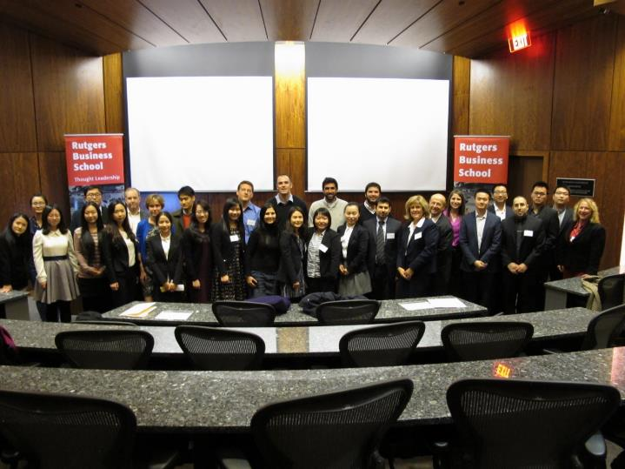

Slide 6
BRIGHAM YOUNG UNIVERSITY
The Ranking of Rutgers in the Accounting Areas
Areas | Ranking 2008-2013 | Ranking 2002-2013 | Ranking 1990-2013
AIS | #1 out of 179 | #1 out of 207 | #1 out of 241
Audit | #6 out of 320 | #7 out of 370 | #11 out of 438
Financial | #70 out of 356 | #89 out of 406 | #83 out of 470
Managerial | #120 out of 286 | #80 out of 346 | #66 out of 413
Tax | #53 out of 129 | #76 out of 178 | #79 out of 246
Other | #35 out of 171 | #18 out of 248 | #25 out of 341

Slide 7
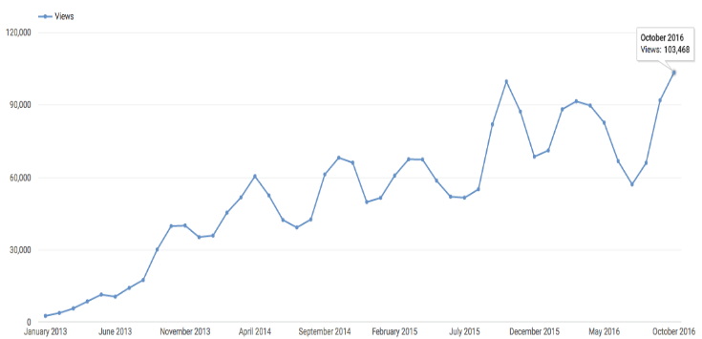
Usage http://raw.rutgers.edu/RADL.html

Slide 8
Content
Undergraduate, Graduate, PhD, & Audit Analytics Content
Undergraduate | Graduate | PhD | Audit Analytics Certificate
Introduction to Financial Accounting Introduction to Managerial Accounting Intermediate Accounting I Intermediate Accounting II Advanced Accounting Auditing Principles Management and Cost Accounting Accounting Information Systems Business Law I Business Law II Federal Taxation I Accounting in the Digital Era Computer Augmented Accounting Decoding of Corporate Financial Communications | Accounting Principles and Practices Information Technology Government and Not-for-Profit Accounting Advanced Auditing and Information Systems Advanced Accounting Corporate Taxation Income Taxation | Special Topics in Accounting Survey of Accounting Information Systems Current Topics in Auditing Machine Learning | Introduction to Audit Analytics Special Topics in Audit Analytics Information Risk Management Tutorials for Risk Management

Slide 9
Our Government Accounting Efforts
Leading Master’s Program in Government Accounting (online)
Linking with our technological leadership
Working with Exchange Regulatory Commissions
  CVM, Indonesia, Korea
Proposing several approaches for government reporting at federal, state, and municipality
Working with the Volcker alliance
Armchair audit work

Slide 10
Introduction to Audit Analytics:
https://www.youtube.com/playlist?list=PLauepKFT6DK8nsUG3EXi6lYVX0CPHUngj
Special Topics in Audit Analytics:
https://www.youtube.com/playlist?list=PLauepKFT6DK-PpuseJtSMlIy-YBhaV4TH
Information Risk Management:
https://www.youtube.com/playlist?list=PLauepKFT6DK8uxePhPCoHjDf8_DlhRtGS

Slide 11
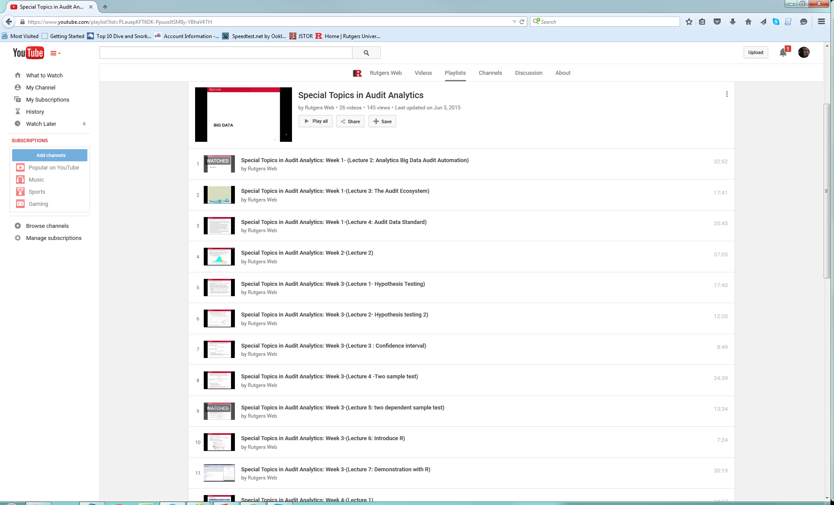

Slide 12


Rutgers AICPA Data Analytics Research Initiative
The mission of RADAR is to facilitate the further integration of data analytics into the audit process, and to demonstrate through research how this can effectively lead to advancements in the public accounting profession.
Additional information can be found at: http://raw.rutgers.edu/radar

Slide 13
Rutgers AICPA Data Analytics Research Initiative
Scope and Objectives
  The scope of the Initiative encompasses the testing of theory and methodology
  Theory and methodology tested under RADAR helped to inform the development of the AICPA Guide to Audit Data Analytics and Analytical Procedures
  The research findings will also serve as the basis for a dialog with the Auditing Standards Board (ASB), the International Audit and Assurance Standards Board (IAASB) and the Public Company Audit Oversight Board (PCAOB)

Slide 14
Rutgers AICPA Data Analytics Research Initiative
Research Projects
  Multidimensional Audit Data Selection
  Process Mining
  Visualization

Slide 15
BIG DATA

Slide 16
Automatic collection
IoT
Where are / were you?
BIG
DATA
Clickpath
Analysis
Mobility
data
Descriptive Statistics
Multi-URL
Analysis
Web data
Hand collection
Scanner
data
Visualization and Dynamics Dashboards
Traditional data
What did you buy?
ERP data
Security
videos
legacy data
What Products relate?
Can you predict results?
News
videos
Can you control inventory online?
Analytic modeling and discovery tools
Social media
E-mails
Media recordings
Can you keep real time inventory?
Media programming
videos
Newspieces
Traditional IT
Security recordings
Telephone recordings
Can you audit inventory real time ?
Unstructured data
Text mining

Slide 17
Exogenous data analytics for Auditing
Miklos A. Vasarhelyi
Helen Brown Liburd
Rutgers Business School

Slide 18
Some sources
Amazon sales
Google searches
Apps used
Calls made
GPS or JEEP location
Sites accessed
Car license plates photographed
Pictures of parking lots
Face recognition pictures
Site clickpaths

Slide 19
Exogenous Data
Social
Media
Internet of
Things
ED may be of easier access
Click
data
Locational data
Economic
data
ED is likely less tamperable
Search
Data
Weather data
ED relationships will be stochastic
Internet sales data
ED is a form of confirmation
ED may create many new procedures
ED may complement many current procedures

Slide 20
Facilitating Citizens’ Voice and Process Reengineering Using a Cloud-based Mobile App
Daniel E. O’Leary
University of Southern California
© 2018

Slide 21
How do Boston and other cities Monitor Infrastructure?
City generated information
  Employee generated (Historical Process)
  City Worker App
  (Maximo Integration (IBM Asset Management))
Data gathered from citizens
  Call Center (Started with the telephone)
  Web Page (Started with the Internet/Web)
  Citizens Connect App (focus of this paper)
  Twitter
It is possible to see “layering of technologies”

Slide 22
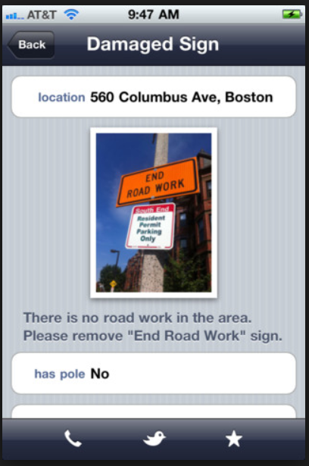
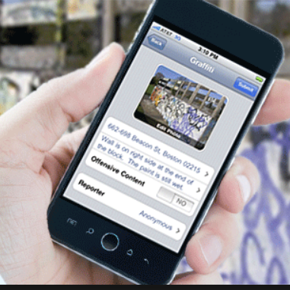
Citizens Connect AKA Boston 311
Cloud-based app allows you to report infrastructure issues
At this point, a number of cities around the US use this app.
Pictures and GPS

Slide 23
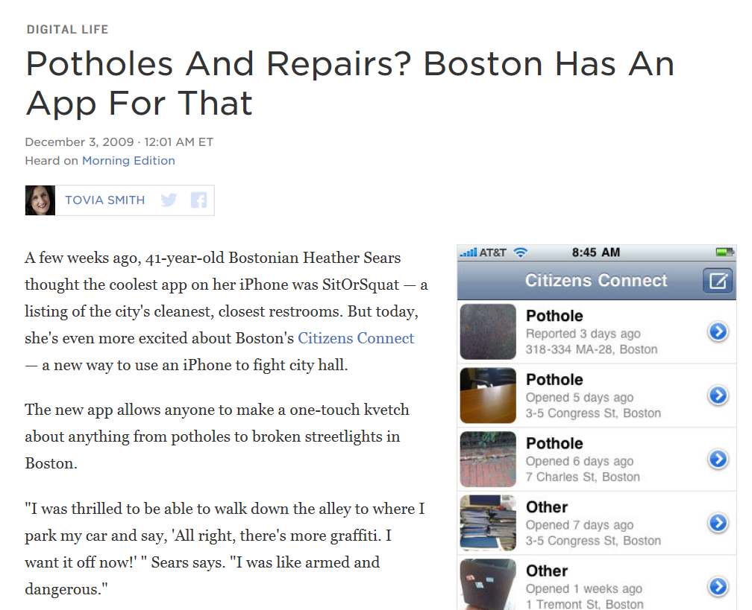
Developed in ~ 2009
How (why) does it work?
“Voice”
“Power to People!”
“Voice”

Slide 24
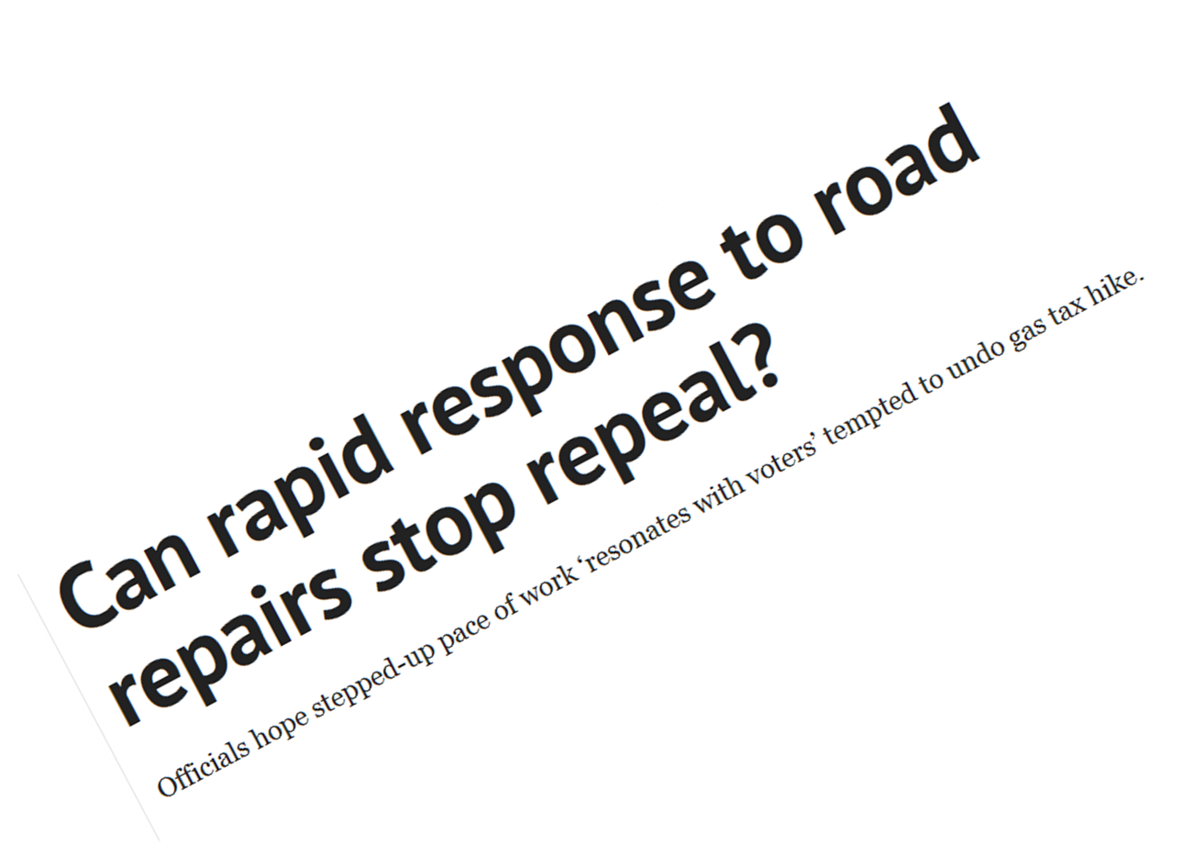
Hirschman’s Exit, Voice, Loyalty
(Provides a theory with which to “think” about use of the app and anticipate what is going on in the data.)
Cloud-based app provides another voice channel to government
With the app, the voice becomes more visible, potentially clearer and actualized in real time
  Phone pictures make reports clearer, GPS can make data better
  Would expect use of pictures may be a key issue in app use
Would expect that the use of the app would grow over time, as people use it to voice their concerns and opportunities.
  Would expect citizens to voice using app if it directly affects them – e.g., in their zip code
Potential forms of exit: Move, Vote against Party, Vote against existing or forthcoming legislation, Make social media remarks against personnel
  Hirschman suggests more voice if exit is difficult
Many forms of “exit”

Slide 25
Imagineering Audit
Jun Dai and Miklos A Vasarhelyi

Slide 26
ASSURING INVENTORY and other things
Supliers
Sales
And managing
everything
E-commerce ordering
Real time recording of sales & cash & receivables
Real time inventory ordering, supplier managed inventory, product mix management
Tracking merchandise path
Real time detection of inventory receiving
Real time detection of inventory reduction
Inventory
GPS
RFID
GPS
Year end physical counts
Year end RFID counts
The Internet of Things
Month end RFID counts
Day end RFID counts
Every second RFID and GPS and e-commerce records

Slide 27
Forget about privacy…. Its gone….
Fortunately you are not very interesting
Technology giveth ….
Technology taketh

Slide 28
Disruption
Apps
Blockchain and Smart Contracts
Deep Learning / AI
Cognitive computing – Siri/ Alexa-like specialized tools
Intelligent Process Automation
Drones and Robots

Slide 29

Blockchain for Accounting and Assurance
By Andrea Rozario & Miklos A. Vasarhelyi
Of Rutgers, the State University of New Jersey

Slide 30
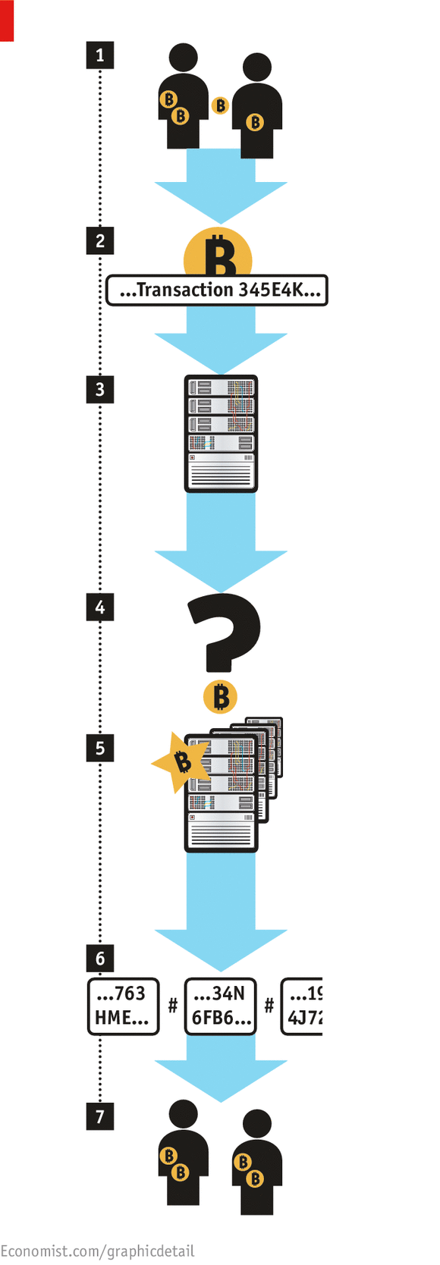
How Blockchain works – Bitcoin Example
Data Analytics

Slide 31
Auditing with Smart Contracts in a Blockchain
April 16, 2018

Slide 32
Introduction
The advent of new technologies has forced businesses to adapt to an electronic world and modify their business practices
Blockchain demonstrates great potential as a tamper-proof audit trail, fused with smart contracts, blockchain can improve business processes
  Bills of lading and debt covenants
How will blockchain and smart contracts disrupt the audit profession?
  Audit blockchain and smart contracts
  Audit with blockchain and smart contracts

Slide 33
Evolving Auditing with Blockchain and Smart Contracts
The traditional audit model was not designed for a digital business environment
Auditors should rethink the audit process in light of emerging technologies
  Blockchain and smart contracts improve process quality and thus have the potential to improve audit quality
  Blockchain provides a unified platform for reliable digital audit evidence and (smart) audit analytics
Smart contracts deployed on a blockchain can facilitate the execution of audit procedures, provide close to real-time audit reporting and more transparency to stakeholders

Slide 34
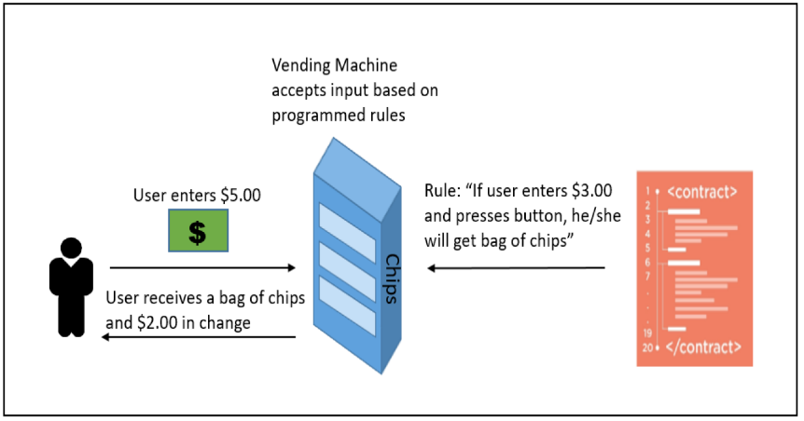
Smart Contracts Background and Relevance to Auditing
Smart contracts are “computerized transaction protocol that executes the terms of a contract” (Szabo 1994)

Slide 35
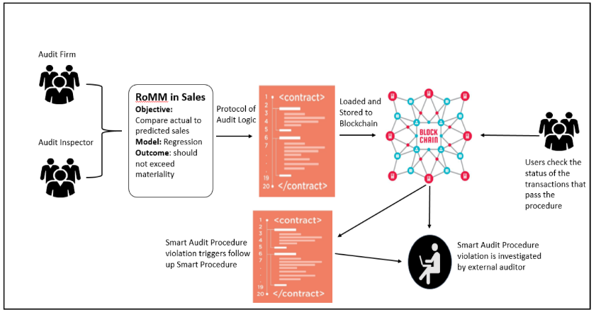
Smart Contracts Background and Relevance to Auditing (cont’d)
Smart audit procedures can help reduce the expectation gap between the procedures auditors perform versus those procedures audit inspectors, and investors, expect them to perform

Slide 36
Initial Scope - Libra Blockchain Audit Tools
Our current
solution scope
Trading Platforms
LedgerX, TeraExchange
Central databases / ERP System / Data Centers
Private Blockchains
Issuance Platforms
Linq, tO
Central databases / ERP System / Data Centers
Exchanges / Payment Processors
Wallets (Coinbase, Kraken, Gemini, etc..) Payment Proc (Bitpay, Circle, etc..)
Central databases / ERP System / Data Centers
Blockchain Tool Providers
Chain, Consensys, Symbiont, Blockstream, Libra
Central databases / ERP System / Data Centers
Oracles
SSAE-16
Notes:
Trading Platforms, :, LedgerX TeraExchang, etc.. These all have central databases / ERP System
/ Data Centers, etc.. We need to get an SSAE-16!!
Issuance Platforms, : Linq, tO, etc.. These all have central databases / ERP System
/ Data Centers, etc.. We need to get an SSAE-16!!
Exchanges / Payment Processors, Wallets (Coinbase, Kraken, Gemini, etc..) Payment Proc (Bitpay, Circle, etc..) These all have central databases / ERP System / Data Centers, etc.. We need to get an SSAE-16!!
Oracles - SSAE-16
BC Tool Providers: Chain, Consensys, Symbiont, Blockstream, IBIT, Monetago, LIBRA, etc.. These all have central data bases / ERP System
/ Data Centers, etc.. We need to get an SSAE-16!!

Slide 37
Conclusion
Blockchain and smart contracts have the potential to disrupt business ecosystems and consequently, the audit ecosystem
Smart audit procedures as a emerging audit analytic tools can change the way audits are performed

Slide 38
Developing A Cognitive Assistant
For Audit Plan Brainstorming Sessions
Qiao Li
Rutgers Business School

Slide 39




Architecture of the Proposed Audit Cognitive Assistant
Open an application
Interface
Luca
Luca
Luca
industry
Client
Processing…
Luca
Recommended Topics:
General understanding, new events, business risks…
Query
Position
You may also interested in:…
Show
Answer
Modules:
Automatic Speech Recognition (ASR)
Language Understanding
Dialogue Management
Natural Language Generation
Text-to-Speech synthesis
Answer
Architecture
Query Classifier
Automatic Speech Recognition
QA
Question or Action
DBMS
Knowledge Base
text
Action
Execute
Action
Audit Related Applications It Can Access
Knowledge Database
backstage supporter
Web Search
Open (ACL, IDEA…)
Calculator
Domain Knowledge
Unstructured data
Knowledge about users
Open standards
Open templates
Audit workpaper
Calendar
…….
Notes:
Replace with visio
Vioce command: ASR
Voice query: ASR&QA
Industry and company must be selected in the beginning of the usage for two main reasons: access control and recommender support. First, in an audit engagement case, the engagement team members should only be authorized to access to information sources that relevant to the case, while data about other clients stored in the knowledge based should not be accessible by these auditors. The selection of industry and client name is the control for information access. Second, since data sources in the knowledge base are supposed to be categorized and tagged, the recommender system and question answering system will process faster in preparing answers under selected industry and client. By choosing the position of the user, such as partner, manager, junior auditor, tax expert, IT expert etc., the cognitive assistant will be able to learn and memorize queries and actions performed by auditors with different experiences and expertise through interactions, then provide relevant and customized recommendations to following users that have are in similar positions. For example, if the audit manager is new to the team, when interacting with the tool, he will receive recommended discussion topics that raised by other senior auditors when they assess risk for this client or similar clients in this industry in prior audit.
Auditors can give commands or ask questions to the proposed system by either (1) voice (by clicking the speaker icon in the interface) or (2) typing. Once a question is asked, the cognitive assistant will generate an answer or open an application based on the command.
Similar to humans, cognitive systems have a way of gathering, memorizing and recalling information, which is the equivalent of human memories. Cognitive systems also have a basic ability to communicate and act.
5.1.3 Architecture
The middle layer is the proposed architecture (process) of the audit cognitive assistant. Auditor interact with the tool by talking to it or typing in the question that they want to ask. Auditor’s voice is processed by the Automatic Speech Recognition (ASR), which translates his speech question into its text equivalent through analytical models. The translated text then goes to Query Classifier which decides if the command is an action or a question. If it is an question, then command goes to the QA system. QA system will extract information from the question, search its databse, and choose or generate best answer to returen to the auditor. If it is an anction, then the command is send back to the system to execute the required application.
4.1.4 Backstage Supporter
Applications
Applications means the third-party apps that are linked with the proposed audit cognitive assistant for direct execution. For IPAs such as Apple Siri, users can use it to create query like “open imessage” or “call ***”, and the related app will be opened. Audit brainstorming meetings are non-stop conversations among a group of people in a short time, and auditors need to refer to various documents to discuss client and make juegements, therefore this function in the cognitive assistant become an “information and task manager” that help improve the work efficiency of auditors during the process and make them focus more on important tasks such as risk discussions. For example , web search allow information that cannot be found in the current knowledge base to be found through existing online search engines. Auditors may be interested to know new information such as economic factors and latest events about a client during the risk assessment, and the best way to access to those information is through general or financial specific online search engines. The System Administrator should track the web searches through this system and organize and incorporate commonly searched terms into the knowledge base.
Knowledge base
The last portion is the knowledge base. Three main information sources - domain knowledge, unstructured data and knowledge about users provide information to support the intelligent decision support functions in the system. The knowledge base stores all relevant data sources that could be used by the engagement team for the risk assessment. Organized knowledge storage free the audit partner and manager from memorizing huge amount of information. It provides efficient information retrieval during brainstorming for question answering and recommendation system.
Text resources are unstructured data sources stored in the knowledge base. Phrases, sentences and paragraphs in all text resources will be tagged based upon pre-determined question category and answer type to enable the information in those texts can be extracted by algorithms during user query. Data sources include financial statements, accounting policies, analytical procedures, litigation, claims, recent news information, audits workpapers, prior year audit deficiencies and adjustments, etc.
Domain knowledge means collected experience and expertise from auditors. Some of these knowledges are important facts about client financial situation that could be collected and prepared before discussion. Some knowledge is judgements or experience that were extracted from prior audit documents, which provide important insight for current new cases. These domain knowledges can be prepared and stored in the cognitive assistant as paired questions and answers for queries, and they should be stored as structured data a relational database.
The third type of knowledge is new knowledge gained through user interactions with the IPA. Based on user’s queries and behaviors, related knowledge is collected for future recommendation in similar situations.
In the big data era, the combination of various data sources with integrated analysis can provide powerful support for auditors and managers. This allows them to be better aware of industry environment and related changes, understand company’s performance, and identify areas of risk on which to focus.

Slide 40
APPLICATIONS OF DATA ANALYTICS: VISUALIZATION AND CLUSTER ANALYSIS OF GOVERNMENTAL DATA
Prof. Miklos Vasarhelyi
Zamil S. Alzamil

Slide 41
Data: Volcker’s Survey Results Data (Average Grades, 2015 - 2017).
  How the U.S. states score on an annual basis on budgeting.
  "Truth and Integrity in State Budgeting: What is the Reality?.“, November 2, 2017.
Using five-variables:
  Budget Forecasting.
  Budget Maneuvers.
  Legacy Costs.
  Reserve Funds.
  Transparency.
Methodology:
  Data Visualization.
  Data Analytics: k-means & hierarchical cluster analysis.
Notes:
- Volcker Alliance’s: The survey produces extensive information about how the different U.S. state scores on an annual basis on budgeting using five measures or variables.
- Volcker Alliance: is a non-profit organization in which they study government performances in general. And improve the efficiency and accountability of governmental organizations.

Slide 42
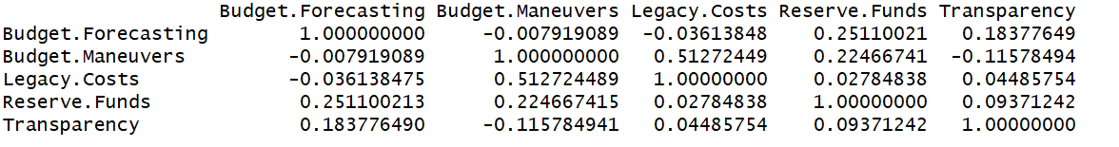
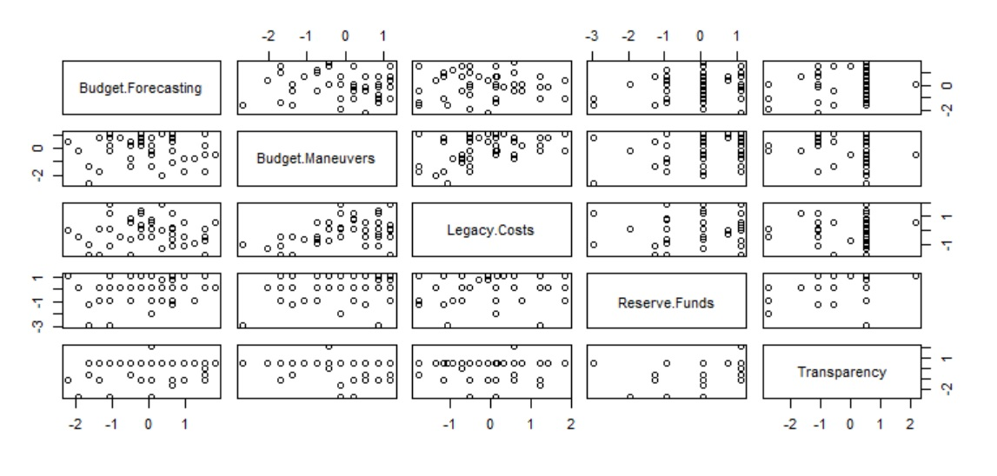
DATA VISUALIZATION
Variables Correlation Coefficient
First we establish that there is a moderate correlation (relationship) between the variables of legacy costs and budget maneuvers (~0.512)
This analysis could assist in:
  More insights into the survey results data.
  Assist in selecting appropriate variables to build models.
Notes:
Correlation Analysis.
First, we show how applying variables correlation coefficient among the five variables could draw some patterns between two variables.
correlation coefficient analysis measure the strength of association or relationship between two variables
There is a moderate positive correlation (relationship) between the variables legacy costs and Budget Maneuvers (~ 0.512).
which indicates that the scores in these two categories are interrelated with each other.
- Also, can assist in selecting appropriate variables to build …
--------------------------------------------------------------------------------------------------------
Scatterplot matrix
Scatterplot matrices are an extension of scatterplots in which each variable is plotted against each other variable in a gridded arrangement.

Slide 43
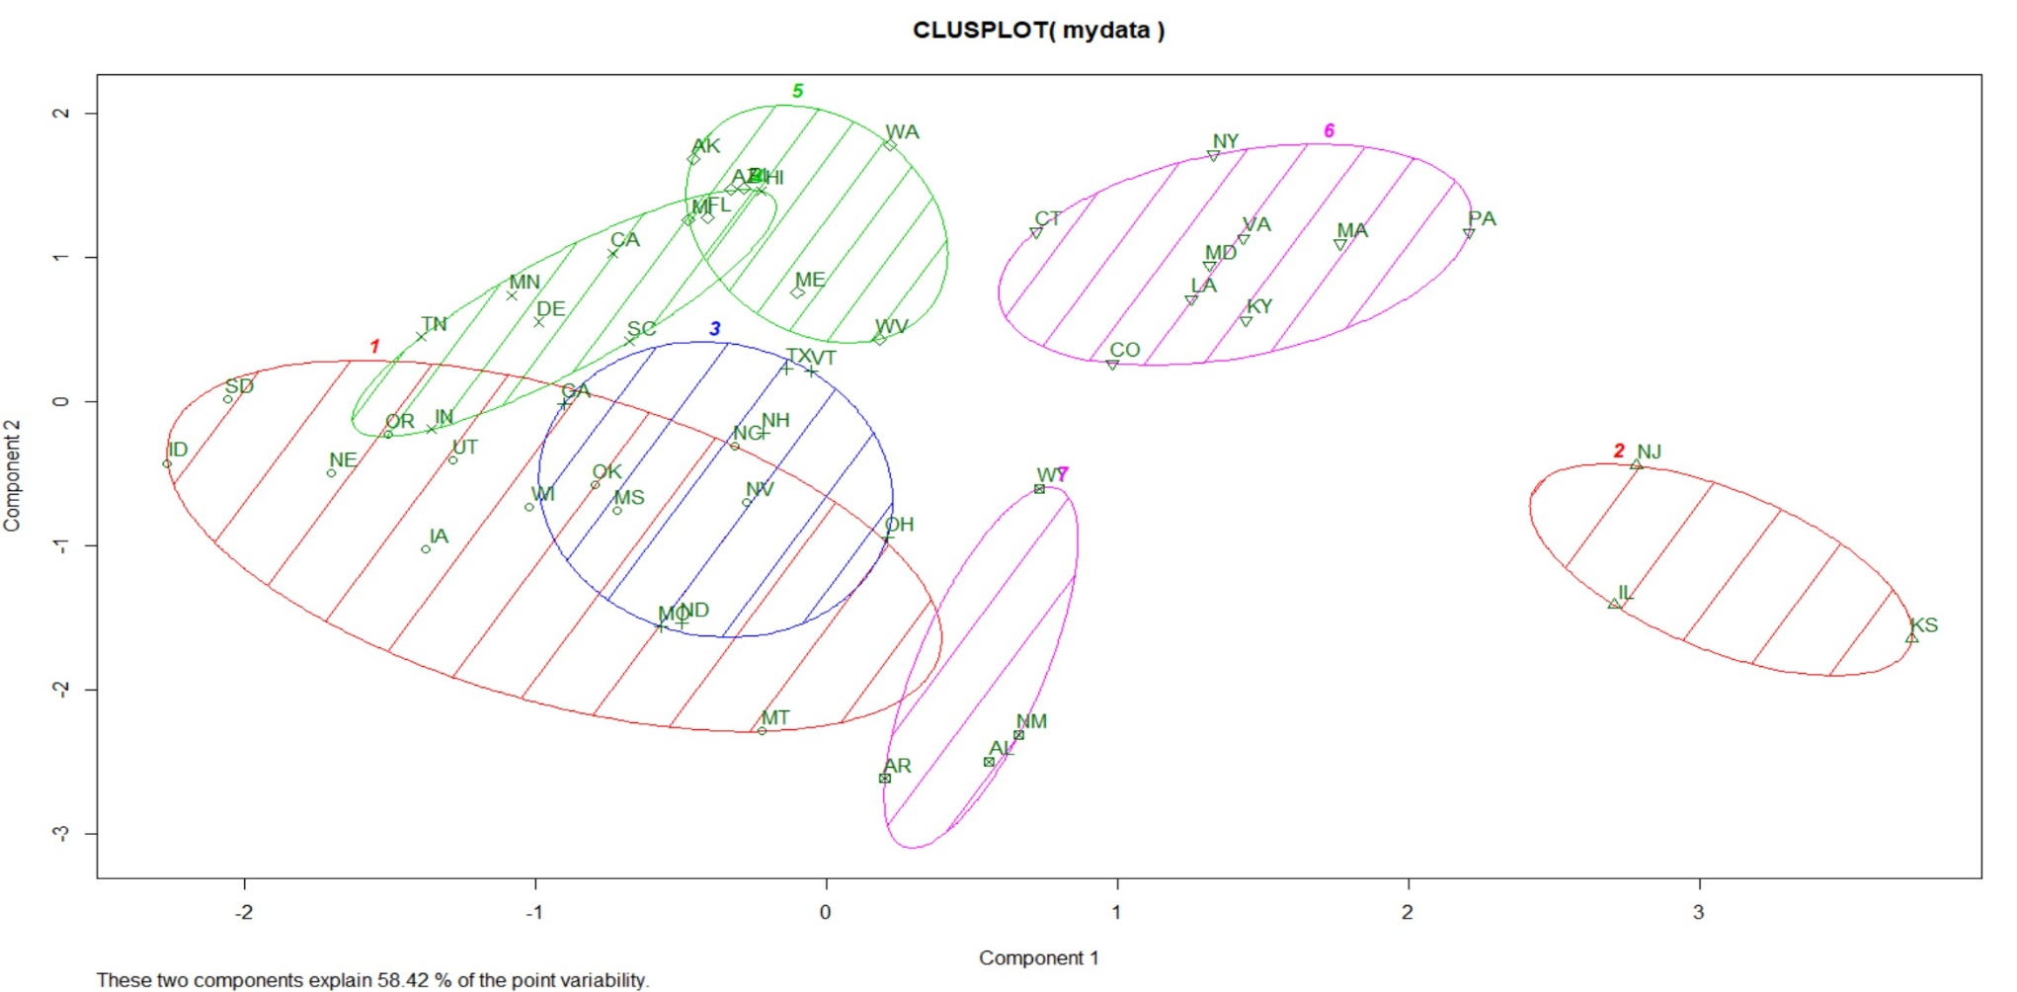
K-MEANS CLUSTERING: Representation of Clusters Solution
PC1 - the direction of the most variation in the data
Notes:
These two “new” (or rotated) axis describe the variation in the data called PCs.
PC1 is the direction of the most variation in the data.
PC2 is the direction of the second most variation.
-------------------
using a 2-dimensional representation, 58.42% of the point variability can be attributed to the scores using the first two principal components.
PCA is a dimensionality reduction methodology….
In future research, I should do other technique to represent my clusters such as heatmap,
The clusters 2 and 7 are more different from each other than the clusters 3 and 5 for example because they lie in the comp 1 plane which has more variance than comp2.

Slide 44
CONT’D
As shown from the previous figure, the states are clustered as follow (based on their scores of these five variables):
  Budget Forecasting.
  Budget Maneuvers.
  Legacy Costs.
  Reserve Funds.
  Transparency.
Cluster | Members
#1 | ID, SD, NE, IA, UT, OR, WI, OK, MS, NV, NC, MT
#2 | NJ, IL, KS
#3 | TX, VT, GA, MO, ND, OH, NH
#4 | TN, MN, DE, CA, HI, SC, IN
#5 | AK, WA, AZ, FL, ME, WV, MI, RI
#6 | CT, NY, PA, MA, VA, MD, LA, KY, CO
#7 | NM, AL, AR, WY

Slide 45
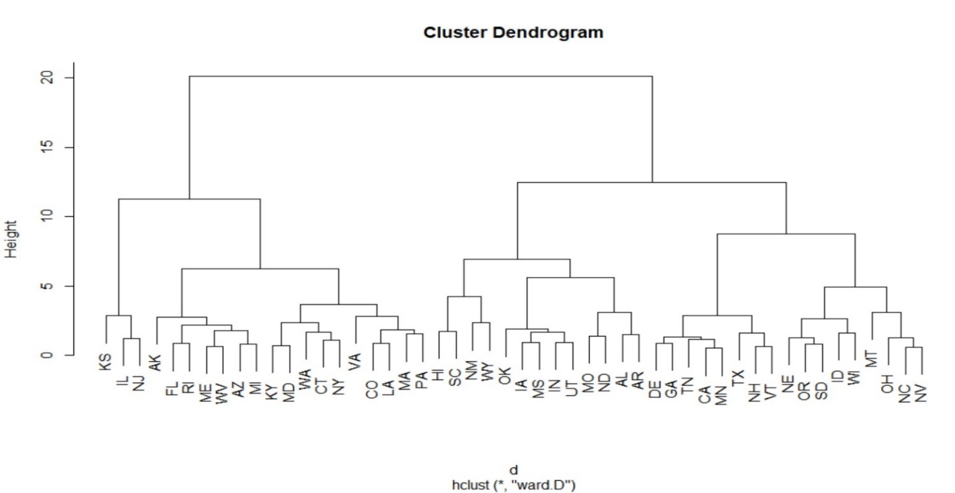
Hierarchical Clustering: A dendrogram Representation of Clusters Solution
Notes:
- A dendrogram or a TREE diagram.

Slide 46
Dynamic Visualization as Audit Evidence
  Graduate School of Management
  Rutgers University

Slide 47
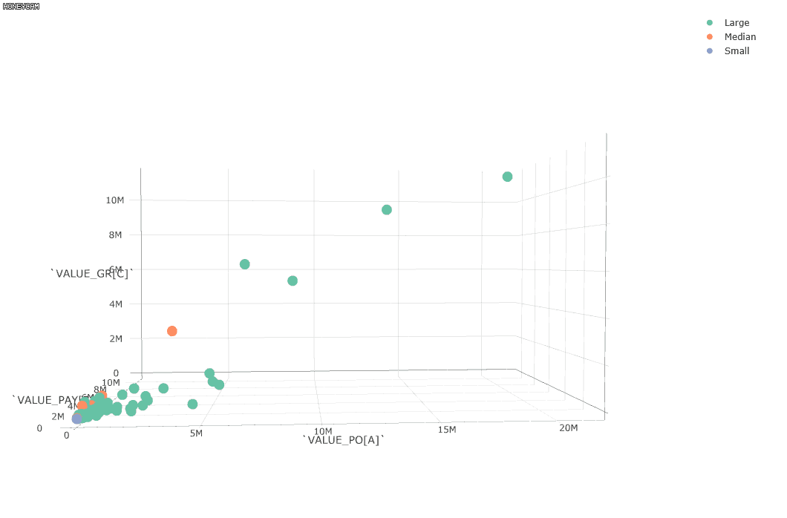
Dynamic Visualization as Audit Evidence
3D scatter Interactive Visualization
Use 3D scatter plot to investigate relationship between more than three values and identify potential risks
Provides more information than using 2D plot
Process Mining Data Log
  Value of Purchase Order
  Value of Payment
  Value of Goods Received

Slide 48
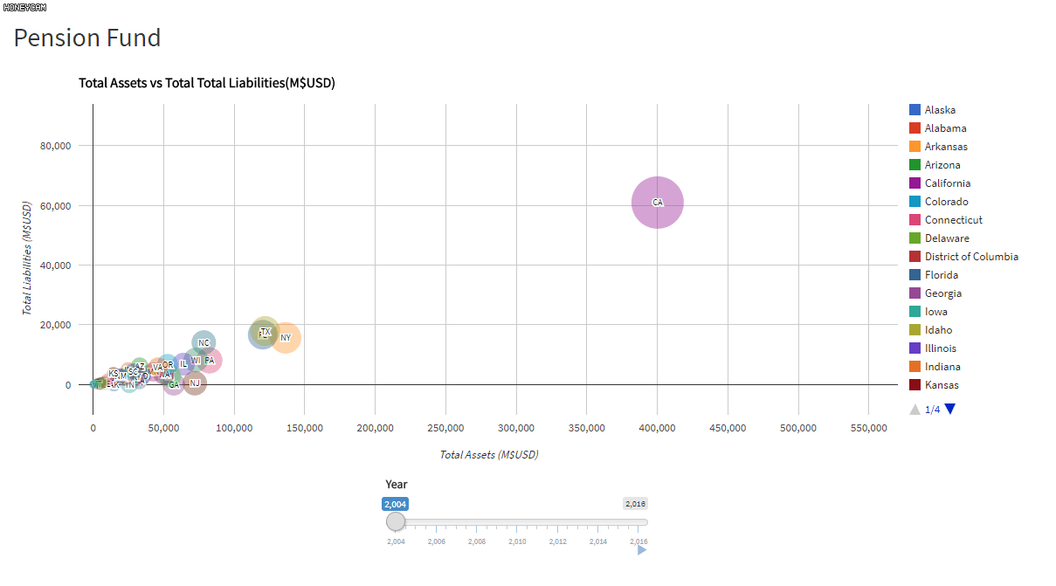
Dynamic Visualization as Audit Evidence (cont’d)
Time Series Interactive Visualization
Investigate the time change of more than 2 values
Select only cases you want to examine with Interactive Visualization Technique
See how the target changes compared with other cases
50 States Comprehensive Annual Financial Report(CAFR) Pension Fund Balance Sheet (2004 – 2016)
  Total Liabilities
  Total Assets

Slide 49
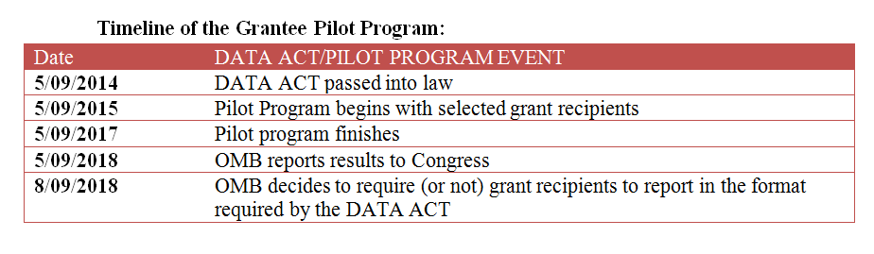
The DATA Act
5/09/2014 DATA ACT is law
5/09/2015 Pilot starts
5/09/2017 Pilot finishes
5/09/2018 OMB reports to Congress
8/09/2018 Pilot becomes law?

Slide 50
The DATA Act
Pilot Program:
Affects state and local governments, transportation authorities, hospitals, universities, charities and not-for-profits
Little standardization in accounting practices across jurisdictions and recipients (Bloch et al 2015)
Standardization of data terms/definitions
Reports must be published in machine readable transparent format
Federal Level:
Separated reports and agencies will now be standardized
Newly formed central reporting website www.usaspending.gov where all will file statements and reports will be published
Currently all financial statements are in PDF: DATA Act requires that reports be in machine-readable and open data format, such as that of XBRL

Slide 51
US Open Data Initiatives
http://www.data.gov
http://www.ohiocheckbook.com
https://data.austintexas.gov/
http://www.transparency.utah.gov
http://www.data.cityofchicago.gov
http://www.checkbooknyc.com/
https://data.cityofnewyork.us/
http://www.data.detroitmi.gov
https://www.usaspending.gov/Pages/Default.aspx

Slide 52
In Brasil, ahead of the US
Data Portal
SPED
SICONFI
etc

Slide 53
Deep Learning
Ting Sun and Miklos Vasarhelyi
Rutgers Business School
July 24, 2016

Slide 54
What is deep learning?
Deep learning mimics how a human brain thinks. It makes a machine think like human.
“The general idea of deep learning is to use neural networks to build multiple layers of abstraction to solve a complex semantic problem.”
-- Aaron Chavez, formerly chief scientist at Alchemy API
Notes:
In a recent AlchemyAPI webinar, Aaron Chavez, IBM Watson (formerly chief scientist at AlchemyAPI), explains the idea of deep learning saying that … (source: Deep learning in the real world-Practical applications for today’s data-driven business, IBM)
Deep learning mimics the way that the human brain thinks.

Slide 55



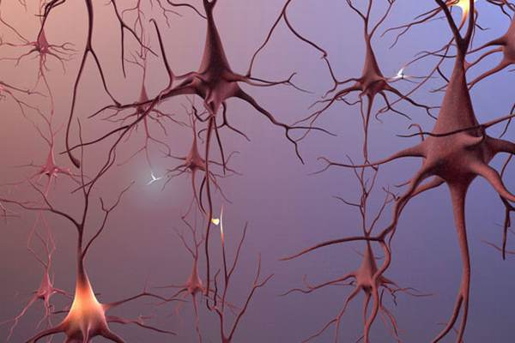
Biological Neurons
Electrical impulse
soma

Slide 56
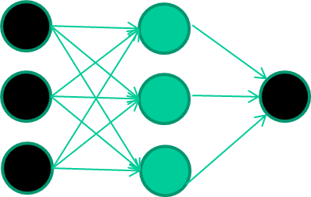

Training data
Fields class
1.4 2.7 1.9 0
3.8 3.4 3.2 0
6.4 2.8 1.7 1
4.1 0.1 0.2 0
etc …
And so on ….
6.4
2.8 0.9
1
1.7 error -0.1
Repeat this thousands, maybe millions of times – each time
taking a random training instance, and making slight
weight adjustments
Algorithms for weight adjustment are designed to make
changes that will reduce the error
Notes:
weight-learning algorithms for NNs are dumb
they work by making thousands and thousands of tiny adjustments, each making the network do better at the most recent pattern, but perhaps a little worse on many others
but, by dumb luck, eventually this tends to be good enough to learn effective classifiers for many real applications

Slide 57
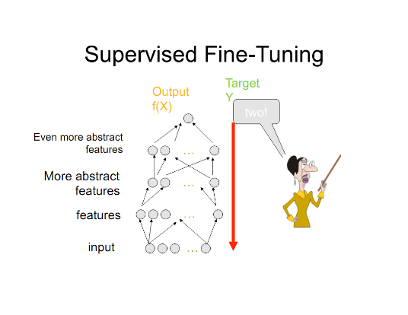
Deep neural network
ANN vs. DNN: The depth of the hidden layers
Extract features from unstructured data like image, audio, video and text
As layers go further, it recognizes more advanced and more abstract features of data
Each successive layer uses features in the previous layer to learn more complex features
Each hidden layer going further into the network is a weighted non-linear combinations of the lower level layers
The entire deep learning process is about refining the weights
Notes:
Deep learning is powerful in processing big data especially the semi-structured or unstructured data. Fed with a large amount of training data, a deep learning system learns what computer scientists call a “hierarchical representation” on its own without human intervene (that is to say, human does not need to manually label attributes of data). The depth of the architecture of the neural networks allows it to extract features from unstructured data like image, audio, video and text .
As I stated, a deep neural network has multiple hidden layers. As layers go further, it recognizes more advanced and more abstract features of data. Each successive layer in a neural network uses features in the previous layer to learn more complex features. Each hidden layer going further into the network is a weighted non-linear combinations of the lower level layers. The entire deep learning process is about refining the weights representing what was learned during unsupervised training. useful for big data as well

Slide 58


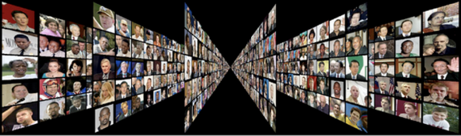

object models
object parts
(combination
of edges)
edges
pixels
Notes:
learn from example

Slide 59
DEEP LEARNING APPLICATIONS IN AUDIT DECISION MAKING
Dissertation Defense
Ting Sun
Dissertation Committee
Chair: Dr. Miklos A. Vasarhelyi
Dr. Alexander Kogan
Dr. Helen Brown-Liburd
Dr. Rajendra P. Srivastava
April 16, 2018

Slide 60
Outline
Introduction
Essay One: The Incremental Informativeness of Management Sentiment in Conference Calls for the Prediction of Internal Control Material Weaknesses
Essay Two: The Performance of Sentiment Features of MD&As for Financial Misstatements Prediction: A Comparison of Deep Learning and Bag of Words Approaches
Essay Three: Predicting Audit Fees with Twitter: Do the 140 Characters reveal a company’s audit risk?
Conclusion, Limitation, and Future Research

Slide 61
Examples of applications
Voice search/voice-activated assistants: NLP
Recommendation engines: scan, keywords
Image recognition
Image tagging/image search: google+
Textual analysis
Notes:
One of the most well known and popular uses of deep learning APIs is to power voice-activated intelligent assistants, a feature found on nearly all smartphones. Today's consumers are pretty familiar with the major players in the smartphone assistant industry.
Many of these assistants can search for movies, music, and other content using natural phrases. The services use natural language processing (NLP) technology, which is based on deep learning, to make media files and content searchable and to augment the platform's vocabulary.
APIs also that allow developers to add speech recognition functionality to their applications.
Major companies such as Netflix, Amazon, Google, Facebook, and Twitter have access to a vast wealth of user generated data. This access to data has allowed these companies to implement complex recommendation systems that provide added value to both users and the companies themselves. a content recommendation engine that “automatically finds
related articles and inserts them into product pages on e-commerce sites ."3 The application uses AlchemyLanguage APIs to scan web pages for keywords and then uses those keywords to find related content.
Google uses image tagging technology to allow Google+ users to search their photos by content without having to tag the photos beforehand.
Facebook is using image tagging to improve the photo sharing experiences of users.
Baidu, the Chinese version of Google, is using deep learning to precisely predict advertising that is relevant to users which has helped significantly increase the company’s revenue.
PayPal using deep learning via H2O, an open source predictive analytics platform, to help prevent fraudulent purchases and payment transactions.
H2O uses advanced machine learning algorithms to analyze data for anomalies indicating fraudulent activity and security threats in near real time.

Slide 62
Design of Apps for Armchair Auditors to Analyze Government Procurement Contract
Jun Dai
Rutgers University
Qiao Li
Rutgers University
Miklos A. Vasarhelyi
Rutgers University

Slide 63

Introduction
Government procurement:
10%-15% of GDP; 7 trillion dollars annually in U.S.
Not always Open and Transparent
Fraud schemes:
bid rigging, bribery, kickbacks, cost mischarging, defective pricing,
product substitution …
Notes:
Each year, governments spend billions of dollars purchasing a wide variety of necessary goods and services to keep the government running. The governments must make sure that they spend money wisely and eliminate waste and abuse of dollars from taxpayer.
Although government contracting system is supposed to be open and transparent, anomalies (procurement fraud )has become one of the most costly types of government fraud.
Cost mischarging means the government is charged for costs not allowable under the contract, when the government is charged for costs relating to a separate contract, or when the government is simply overcharged. Defective pricing occurs when there is a falsification or inaccurate submission of related costs by the contractor or its agent (White house, 2015). Collusive bidding schemes where bidders conspire to rig prices can similarly trigger False Claims Act liability (Whistleblower, 2015). More specifically, one example of procurement fraud could be that a company use bribes to win a contract even when it did not make the lowest or best bid. Other examples of contractor fraud include billing the government for incomplete work, charging the Government higher labor rates than those agreed to in the contract, and issuing kickbacks.
Different countries have their own laws regarding to government procurement.

Slide 64
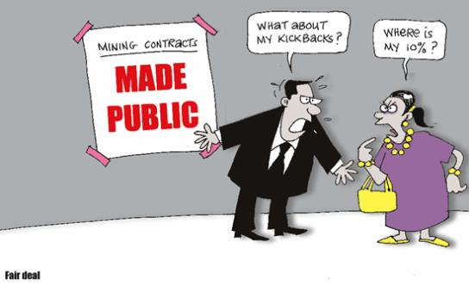
Introduction
What data to use?
Who has interest?
How to detect anomalies?

Slide 65
Background
Open Data Initiatives
Make info available and transparent
45 countries and 163 international regions
U.S.
  Data.gov
  39 states and 46 cities and counties
  formats: Excel, CSV, XML, API, HTML, open XML, text, pdf
Government procurement data:
  China: ccgp.gov.cn
  Australian: tenders.gov.au
  Canada: buyandsell.gc.ca
  Brazil : dados.gov.br
  UK: gov.uk
Data Standards :
Different data structure, format, and field names
AICPA: Audit Data Standards
Help build data model for ERP and audit apps
Notes:
“open”: anyone can freely access, use, modify, and share for any purpose
The content covered in these databases include data of agriculture, business, education, energy, health, manufacturing, finance, public safety, global development, federal and local government contracts, etc
U.S., U.K., Brazil, Canada, Singapore, India, China etc

Slide 66
Background
Open Data Initiatives
Make info available and transparent
45 countries and 163 international regions
U.S.
  Data.gov
  39 states and 46 cities and counties
  formats: Excel, CSV, XML, API, HTML, open XML, text, pdf
Government procurement data:
  China: ccgp.gov.cn
  Australian: tenders.gov.au
  Canada: buyandsell.gc.ca
  Brazil : dados.gov.br
  UK: gov.uk
Notes:
“open”: anyone can freely access, use, modify, and share for any purpose
The content covered in these databases include data of agriculture, business, education, energy, health, manufacturing, finance, public safety, global development, federal and local government contracts, etc
U.S., U.K., Brazil, Canada, Singapore, India, China etc

Slide 67
Background
“Armchair Auditor”
-- Crowdsourcing analysis of government data (DE O’Leary, 2015)
-- Informal, voluntary and no requirements
Government operation
Government open data
Private tools
Public tools
Interested parties:
Auditors
Vendors
Politicians
Public (citizens)
The press
Business Competitors
Politician
Notes:
People who interested in local gov., public good, economic reason, political reason
Who are interested in local government spending
Want to hold government to account for how their tax money is spent
economically, the press/medie hard to have interest if there is no bad news, they only consider news worthy
Competitors: of they found anomalous expenses they can get direct economic payoffs; if not, simply know who work with gov can give them information that lead them to compete with that competitor
Competitor of the politician responsible for the particular expenses, they want to find inappropriate expenses of competitors
Originally, definition is a website that uses open spending data of councils to generate reports for council spending
An armchair auditor is a person, who could be any citizen that has interest to examine and analyze government expense data.
analysis is informal, voluntary and no requirements on armchair auditors
Different from outsourcing, crowdsourcing obtain needed services, ideas, from a large group of people and especially from the online community rather than from traditional employees or suppliers
people can break down spending by council service, and provides both a high-level view of how much money is being spent by each council service or paid to each supplier. Visitors can examine the details by choosing expense type, service area, suppliers, and amounts of payments, and integrated government data with calculations is then presented for visitors to download and use.

Slide 68

Background
“Armchair Auditor”
Pilot projects:
  2 English councils: Isle of Wight council and Hull City council
  calculated government payments information
Achievements
in 2011, a group of activists uncovered a £1.3m audit scandal at their local council (Patrick, 2011; Patrick, 2011)
Barrier:
Quality and comparability of information
Tools and knowledge
Rules and community
Notes:
The most obvious barrier is the quality and comparability of information, but data analytics ability will improve in the future as new applications making it easier to calculate, compare, and detect problems. provide calculated government payments information for two
Issues！

Slide 69
Objective
  Although we have open government data,
  few studies discuss:
  how to use
  what tools
This paper :
Propose a list of audit apps that help armchair auditors to
analyze open government procurement data
Spot anomalies and identify potential issues
find out suspicions contracts which have higher probability of fraud
Notes:
Find inappropriate expenses
few studies or applications done that discuss how to organize and integrate those data for “armchair auditors” to use and analyze,
what kinds of analysis could been done to monitor expenditures and detect potential frauds, and what data analytics tools can be used and how to use them
providing various functions that allow detailed investigation
validating contractor qualification, checking order changes, detecting defective pricing, etc
can be applied to different countries

Slide 70
Why Audit Apps
What is it
Formalized audit procedures that are performed through computer scripts (Dai et al. 2014)
Example
Caseware and ACL: test journal entries, account payable, assets, etc
Advantages
simplify data analytics procedures, require few user interactions, improve audit quality
No apps for open government data analysis or for non-professional auditors such as “armchair auditors”
Notes:
Such test can range from simply query such as detecting duplicate payments and identifying special transactions performed on holidays, to advanced data analytics techniques such as Benford’s Law (Nigrini 1999).
One function, can be a module in a tool
Audit apps usually require few user interactions, i.e., users only need to load data into audit apps, and then obtain results without many complicated operations. Auditors can even create customized audit apps that accomplish special audit tasks. Compared with traditional audit software, audit apps are easy to use, much cheaper, and require less training or data analytics background of users. Audit apps can simplify data analytics processes, and therefore facilitate auditors to perform efficient and effective data-analytics-based audit tests.

Slide 71
Proposed Apps for Government Expenditure Audit
Anomaly Type:
1. Data incompleteness and unreliability
No. | Purpose of the app | Data needed | Anomaly Indicator
1 | Contract values check (unusual “0” and tiny) | initial values of contracts | Unusual number in the values, such as 0, 0.01,0.05
2 | Data Completeness and Integrity Check (Missing suppliers / biding mode/ dates) | contracts data | Missing values
Notes:
we propose a framework that armchair auditors should consider when develop or use apps when analyzing government procurement contracts.
Charging for products not used or services not rendered is “one of the simplest ways for contractors to steal funds, yet one of the hardest schemes to prove. In these cases, products or services are billed but not used under any contact, with all money collected as profit for the company”.

Slide 72
2. Unqualified suppliers
No. | Purpose of App | Data needed | Anomaly Indicator | Potential Fraud
1 | Relationship check (gov. personnel VS contractor) | Background information of both parties | employment of contractor or sub-, or their family member in government personnel | Bribery, Kickback
2 | Contractor qualification check (“blacklist” companies) | Contractor information, “blacklist” | Contractor once occurred in the “blacklist”
3 | “Waived bidding” contracts check | Bidding type information | firm has very high percentage of “waived bidding” contracts in all contracts with gov
4 | Bids wining history check | Statistic contract data | a certain contractor always or never wins a bid, or all contractors win an equal volume of contracts over time | bid rigging
Notes:
Guidance:
Procurement Fraud Handbook
prepared by the General Services Administration (GSA) Office of Inspector General (OIG) (GSA, 2012)
An example of bribery is “a contractor paying a contracting officer in exchange for being awarded a lucrative contract”. Kickback is “providing something of value in exchange for preferential treatment”. A common conflict of interest is “conducting business with related parties, as it often leads to favoritism. A contracting officer awarding a contract to her husband’s father’s company, for example, might be an administrative conflict of interest.”

Slide 73
3. Unnormal prices
No. | Purpose of App | Data needed | Anomaly Indicator | Potential Fraud
1 | Contract prices comparison (gov. VS other clients) | Prices to different clients | Contractor submit higher price bids to government for exactly same product /service | bid rigging
2 | Split purchases detection | Contract | Contracts with same suppliers, same dates and same goods
3 | Winning price prediction (Regression) | Bidding process | Abnormal winning price | bid rigging
Notes:
An example of bribery is “a contractor paying a contracting officer in exchange for being awarded a lucrative contract”. Kickback is “providing something of value in exchange for preferential treatment”. A common conflict of interest is “conducting business with related parties, as it often leads to favoritism. A contracting officer awarding a contract to her husband’s father’s company, for example, might be an administrative conflict of interest.”

Slide 74
4. Unnormal bidding procedure and mode
No. | Purpose of App | Data Needed | Anomaly Indicator | Potential Fraud
1 | Monopoly check | Market data | only very fewer suppliers | bid rigging, Collusion
2 | Bidders withdraw detection (in a short time period) | Bidding process information | Qualified bidders inexplicably withdraw valid bids | bid rigging
4 | Law check | Procurement law; bidding mode | The bidding process doesn’t comply with the law (such as waive of bidding) | Bribery, Kickback
Notes:
Charging for products not used or services not rendered is “one of the simplest ways for contractors to steal funds, yet one of the hardest schemes to prove. In these cases, products or services are billed but not used under any contact, with all money collected as profit for the company”.

Slide 75
5. Unnormal products or services implementation
No. | Purpose of the app | Data needed | Anomaly indicator | Potential Fraud
1 | Address check (company’s & delivery) | addresses | Delivery location is not the office, plant, or job site | Charging for products not used or services not rendered
2 | Weird working hours check | invoices | Employees bill for more hours than typically worked in a day | See above
Notes:
Charging for products not used or services not rendered is “one of the simplest ways for contractors to steal funds, yet one of the hardest schemes to prove. In these cases, products or services are billed but not used under any contact, with all money collected as profit for the company”.

Slide 76
Proposed Framework
Anomaly type
Data incompleteness and unreliability
Software Platform
Unqualified suppliers
Unnormal prices
General analytics sw
Unnormal bidding procedure and mode
Audit analytics sw
Unimplemented products or services
Visualization sw
Data type
Basic
Inside info
Other outside data
Gov open data
High
Statistics
Medium
Machine Learning
Low
Technology
Knowledge Level
Notes:
Proposed Framework to Consider Starting Armchair Audit in Government Expenditure
anomaly type (?), 2) open data type, 3) technique, 4) tool, and 5) armchair auditors’ knowlede level.
when people want to start this, there is no community, no guildance,
Depend on what data the gov provides
Issues of his paper mentioned
If someone has knowledge and inside info, best to find out issue
Due to the lack of guidance, armchair auditors, especially ones with less auditing knowledge and experience, may only examine portions of open data, execute partial analyses by using a limited number of apps, and concentrate on issues they specialize in. In order to improve the quality of armchair audit, and facilitate the design of efficient and effective apps, we propose a framework that armchair auditors should consider when develop or use apps when analyzing government procurement contracts.
Basic: filter, matching,linking
R, SAS, and Weka are widely used general data analytics software. Popular audit analytics software includes ACL and Caseware IDEA. Examples of visualization software are Qlikview and Tableau.

Slide 77
Proposed Audit apps | Anomaly type | Data | Techniques | Software Platform | Knowledge Level
Descriptive dashboard | Data incompleteness and unreliability | Contract | Descriptive Analysis | Qilk sense | Medium and above
Missing values | Data incompleteness and unreliability | Contract | Query | IDEA | Low and above
Split purchases | Contracts with same suppliers, dates and goods | Contract | Matching | SAS | Medium and above
Winning price prediction | Abnormal winning price | Bidding process; Goods and service | Regression | R | Medium to high and above
Suppliers cluster | Unqualified suppliers | Contract; Supplier; Bidding process | Clustering | R | Medium to high and above
Abnormal actions in a bidding | Unfair bidding process | Biding process | Classification | R | Medium to high and above

Slide 78
Illustrations
Data:
Contracts of Brazil federal government from 1989 to 2014 from SIASG (Brazilian public federal procurement information system)
Descriptive dashboard
Software : Qlik Sense Enterprise
-- dashboard for visualization
Notes:
The contract data contains information of contractors, contractees, bidding modes, objects, legal foundation, starting dates, end dates, initial values, etc.
demonstrate audit apps that perform data-analytics-based audit tests on those data.
Visualization is one of the most efficient techniques to perform descriptive analysis. Using tables, graphs, and charts, armchair auditors can explore data and obtain simple and intuitive insights. We use the software “Qlik Sense Enterprise” to demonstrate audit apps that perform descriptive analyses. Armchair auditors can use this software to create customized audit apps by putting their preferable tables, graphs, and charts into a dashboard， and reuse the dashboard monthly or even weekly. The customized audit apps can help auditors preform targeted data analytics on a frequent basis, and detect anomalies in time

Slide 79
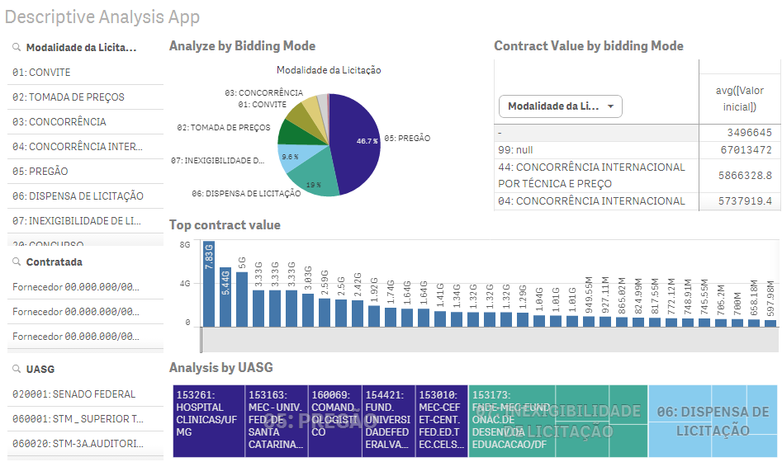

Slide 80
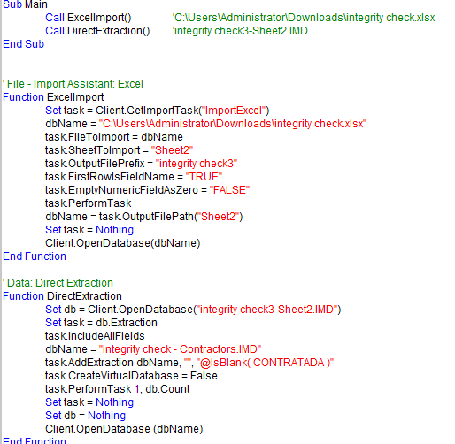
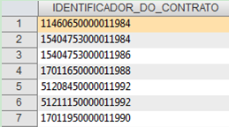
App script
Data incompleteness and unreliability Check
Software : Caseware IDEA
-- Integrity Check for Missing Contractors
Integrated results:
For contracts that lost contractor records, 90% belong to waived bidding
In 470,683 contracts,
35,516 contracts lose contractor information
6,167 contracts lose bidding mode
1,000 contracts lost valid dates
Sample results
Notes:
For contracts that have no information about contractor, 90% of them belong to “06””07”- waived bidding
The results show that among a total of 470,683 contracts, 35,516 contracts do not have contractor information, 16,167 contracts are missing information of bidding mode, and the starting date or end date are not shown in 1,000 contracts
In the contract data, contractors, bidding modes, as well as the starting and end dates of the contracts are critical information. Missing values in those fields may indicate high risks of fraudulent contracts. Therefore, we create apps using Caseware IDEA scripts to examine data completeness of contractors, bidding modes, and the starting and end dates of contracts, and report contracts with missing values in those fields. With those scripts, armchair auditors can easily perform integrity check on Caseware IDEA platform with one click, and detect missing values in time

Slide 81
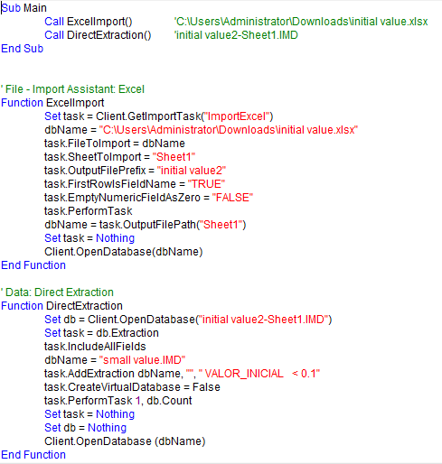
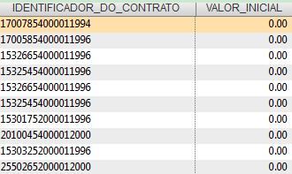
App script
Data incompleteness and unreliability Check
Software: Caseware IDEA
-- unusual initial values
Integrated results:
501 contracts that have “0” value after removing contracts pertaining to government departments
527 contracts have values that <1; the values are 0.01, 0.05, 0.1, and 0.53 Brazilian real
Sample results
Notes:
detect contracts with initial values under 0.1 Brazilian real

Slide 82
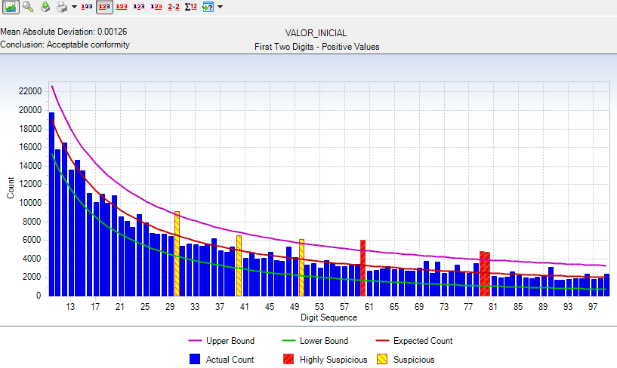
Widely used for accounting fraud detection
Values should come from mathematical combination of numbers (quantity × price), they are expected to obey Benford’s Law
First Two Digit:“60”, “79” and “80” do not obey the First Two Digit Law
Unnormal prices
Software: Caseware IDEA
-- Benford’s Law Check
Notes:
detect contracts with initial values under 0.1 Brazilian real

Slide 83
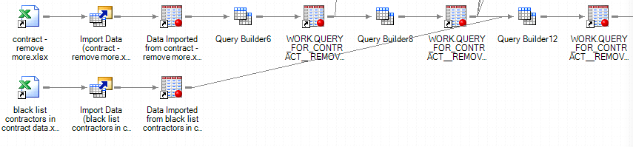
Unqualified suppliers
Software: SAS
--“black list” Contractor Detection
APP
Sample results
Integrated results:
25,100 contracts are made with contractors listed in the blacklist
1,936 unique suspicious contractors (firms)
Contractor | Frequency
33.000.118 | 1717
00.212.655 | 405
29.739.737 | 404
10.788.628 | 375
00.329.379 | 345
Notes:
We create an audit app that detects contractors on the black list using SAS Enterprise software. Armchair auditors can easily operate the audit app on SAS Enterprise platform with one click.

Slide 84
Unnormal bidding mode
Software: Excel
-- Big Data Collection
legal foundation explaining why the contract can waive bidding processes
Contract ID | Bidding Mode | Objective | Link to legislation
11460650000011984 | 06: DISPENSA DE LICITAÇÃO | Contratação de imóveis para instalação da Agência do IBGE nomunicípio de Conceição do Araguaia/PA. | De acordo com artigo 24, Inciso X, da Lei 8.666/93____C/CR.PR. 06/96, ARTIGO 3.
38004450000011992 | 06: DISPENSA DE LICITAÇÃO | Contrato de locação do imovel da Av. Dr. Vicente Machado n.º 362 -Curitiba/PR. | Art. 24, Inciso X, da lei 8666/93.
17011650000011988 | 07: INEXIGIBILIDADE DE LICITAÇÃO | Contrato nº 01/88 tem por objeto a locação dos imóveis nºs 26, 38 e44 da Praça Oliveira Figueiredo, Barra do Piraí, Estado do Rio de Janeiro. | Decretos-Leis nos. 2300/86 e 2348/87 e Lei 6649/79
17011950000011990 | 06: DISPENSA DE LICITAÇÃO | Locação dos imóveis de nos. 26, 38 e 44 da Praça Oliveira Figueire-do para abrigar a Agência da Receita Federal em Barra do Pirai | Decretos-Leis nos. 2300/86 e 2348/87 e Lei 6649/79
Notes:
legal foundation shows the corresponding article numbers that the contracts should obey in order to waive bidding processes

Slide 85
Limitations and Future Research
Design, improve and test the apps
developing rule-based algorithm for improved government procurement anomoly detection, applying the idea of exceptional exception (Issa, 2013) to rank suspicious contracts based on predefined rules
Notes:
There are two limitations of this paper: firstly, the proposed app list can be enriched for more potential fraud risk situations; secondly, besides the three software used in this study, there are some other data analytical tools that are widely used in the audit domain (such as ACL and R) and should be considered when building government procurement audit apps for various users. In the future research, besides expanding the app list and applying other analytical tools, we are considering developing rule-based algorithm for improved government procurement fraud detection, applying the idea of exceptional exception (Issa, 2013) to rank suspicious contracts based on predefined rules.

Slide 86
To Wrap Up!

Slide 87
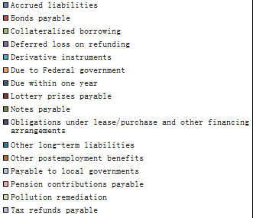



What we expect from it!
Electronic reporting system should be able to:
Facilitate the medium to allow for a more transparent modern government reporting
Increase the transparency in governmental reporting
Modernize the supply of information for bond analysis
Provide customized reports
Facilitate the diffusion of financial information
Customizable reports
XBRL enables two foreign computers to communicate

Slide 88
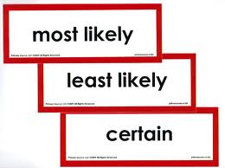
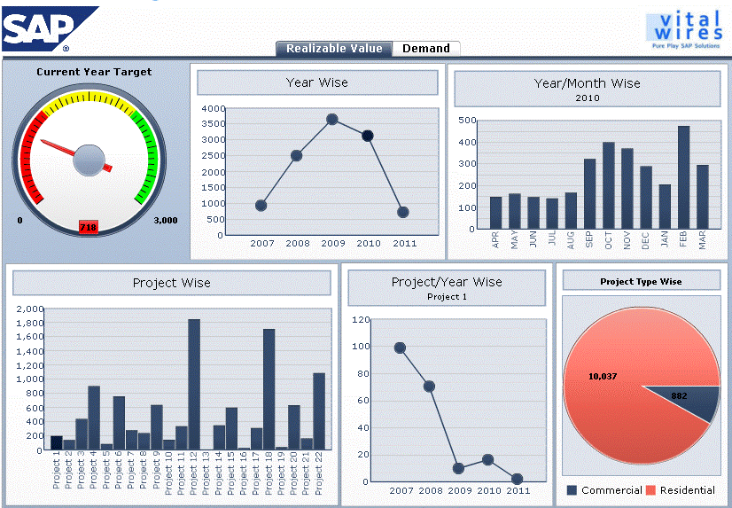

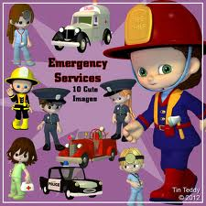
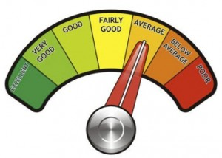
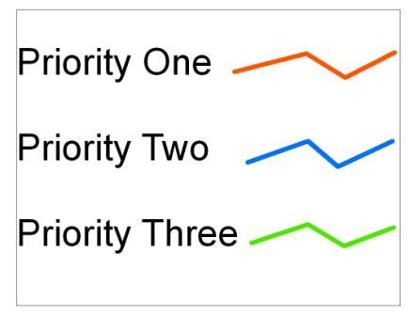
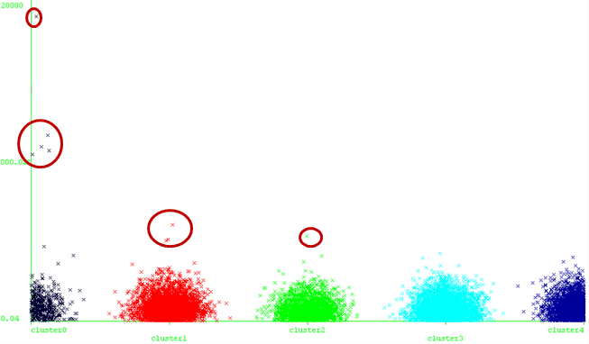

What we expect from it!
Anomalies!!!
Exceptional Exceptions: detect, rank & prioritize anomalies
Compliance with GASB: Identify poor & anomalous reporting
Identify entities in financial distress at an early stage
Enable measuring the likelihood of defaulting
Compare similar entities
Tailor information to satisfy different stakeholders’ needs
Facilitate access to real-time information (Dashboard)
Eventually enable the generation of continuous and real-time reports (continuous auditing & monitoring)
Entity 1
Entity 2
Danger! Danger!
Anomaly! Anomaly!
Dashboards
On Demand Continuous Audit & Monitoring Reports
STOP!
This reporting is POOOOR!!!

Slide 89

Thank you!
Notes:
There are two limitations of this paper: firstly, the proposed app list can be enriched for more potential fraud risk situations; secondly, besides the three software used in this study, there are some other data analytical tools that are widely used in the audit domain (such as ACL and R) and should be considered when building government procurement audit apps for various users. In the future research, besides expanding the app list and applying other analytical tools, we are considering developing rule-based algorithm for improved government procurement fraud detection, applying the idea of exceptional exception (Issa, 2013) to rank suspicious contracts based on predefined rules.

